Slide 1

Improved Boomerang Attacks on the Lightweight Block Cipher KATAN
SV
Teh Je Sen, Dr.
Speaker
LI YU
School of Computer Science Universiti Sains Malaysia

Slide 2
Part 01
INTRODUCTION
Part 02
LITERATURE REVIEW
Part 03
METHODOLOGY(WORKING)
Part 04
RESULT AND DISCUSSION(WORKING)
OUTLINE
Part 05
CONCLUSION AND FUTURE WORK(NOT START)

Slide 3
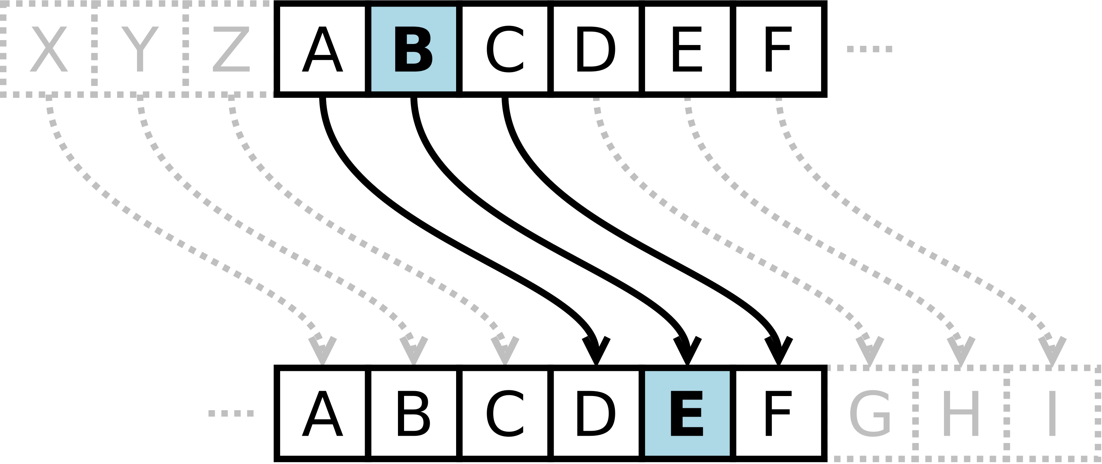
Background
Cryptography be used to protect information from curious eyes. The applications of modern cryptography including symmetric-key, public-key and hash function.
Put research pictures here
Caesar cipher is one of the simplest and most widely known encryption techniques.
Notes:
Remember not to spend too much time on these introductory slides.

Slide 4
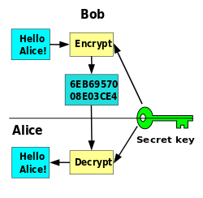
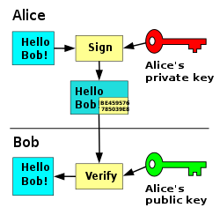
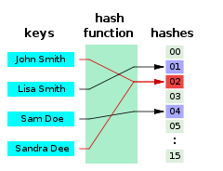
Background
Put research pictures here
Symmetric-key encryption
Public-key encryption
Hash function
These diagrams shows the principle of three encryptions.
Notes:
When you present, you do not need to explain public-key and hash. You can say there are three main categories of cryptographic primitives but the focus of this dissertation is symmetric-key encryption.

Slide 5
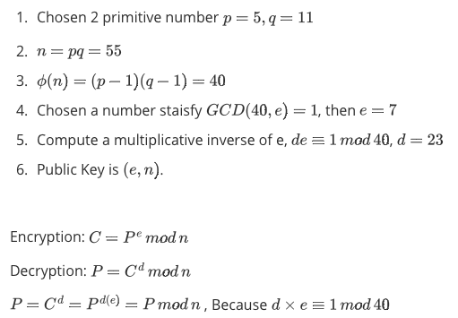
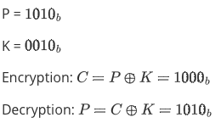

Background
A simple example of Symmetric-key encryption
A simple example of RSA
A simple example of Modular Hash function
These diagrams shows the principle of three encryptions.
Notes:
You can show this slide, but no need to explain in detail. If you want, just quickly explain symmetric-key encryption only.

Slide 6
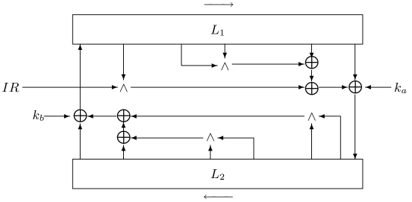
Background-Lightweight Cipher
Fig. The Outline of a round of the KATAN/KTANTAN ciphers
Lightweight cryptography - Cryptographic algorithm tailored for implementation in constrained environments including RFID tags, sensors, contactless smart cards, healthcare devices, and so on.
KATAN family is a lightweight cipher and a hardware-oriented block ciphers. .
Notes:
I have simplified the explanation for this slide and you can introduce KATAN here as an example of a lightweight cipher.

Slide 7
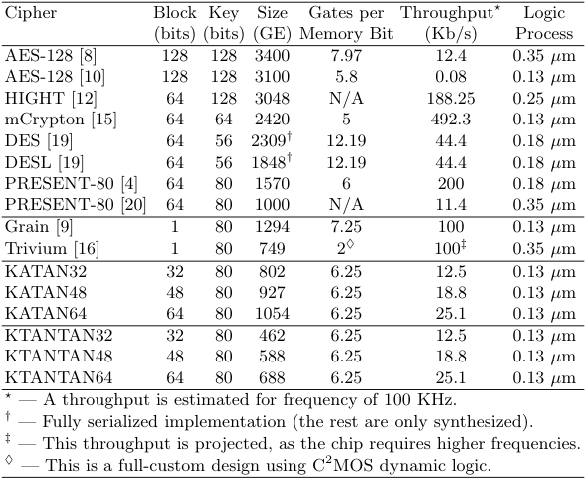
Background-Lightweight Cipher
KATAN family has three variants - KATAN32, KATAN48 and KATAN64.
The name implies the block size, e.g. KATAN32 has a 32-bit block size.
It uses an 80-bit secret key that is expanded into 508 subkey bits.
There is a variant of KATAN known as KTANTAN with a simplified key schedule.
Table 1. Comparison of Ciphers Designed for Low-End Environments (optimized for size).
Notes:
You can mention that there is a variant called KTANTAN with a simple key schedule. But the focus of your work is KATAN.

Slide 8
Background-Lightweight Cipher
The advantages of KATAN family.
KATAN family has implemented the 8-bit LFSR counter.
The 8-bit LFSR counter took 60 gates but 8-bit counter took 80 gates.
The speed of the 8-bit LFSR is faster than the one for 8-bit counter.
The 8-bit LFSR counter is more irregular manner than in a counter, can enhance security of KATAN
Notes:
The design goal of KATAN is having a secure cipher with a small hardware footprint. So, the advantage of KATAN is its LFSR-based design which reduces the gate count. The irregular update is not an advantage of KATAN, it is just a design strategy to improve its security. You can modify this slide to just highlight the goal of KATAN (mentioned earlier) and the reduction of gate count by using LFSR (the left block). The right block is not needed.

Slide 9
Background-Differential Attacks
The differential attack is one most effective methods to attack iterative block ciphers, and it is an important index for evaluating the security of block ciphers.
The process of Differential Attack:
Find the nonlinear part of the cipher, exp. S-BOX for Present, bitwise AND of KATAN
Create Differential Distributed Table(DDT)
Use DDT to find the best differential path
Use the best differential path to create a valid distinguisher.
Notes:
Again, KATAN does not use modular addition. It uses bitwise AND.

Slide 10
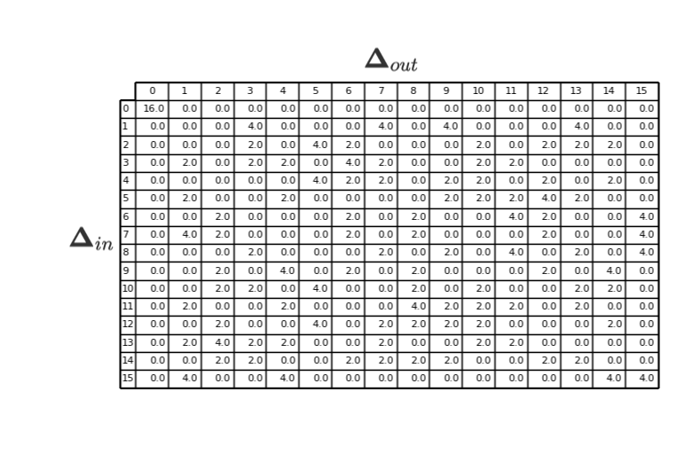

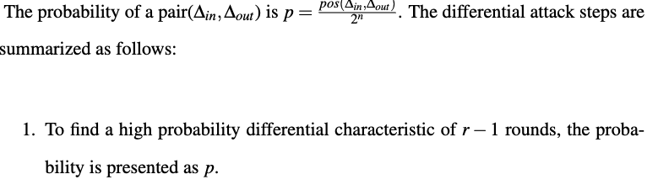
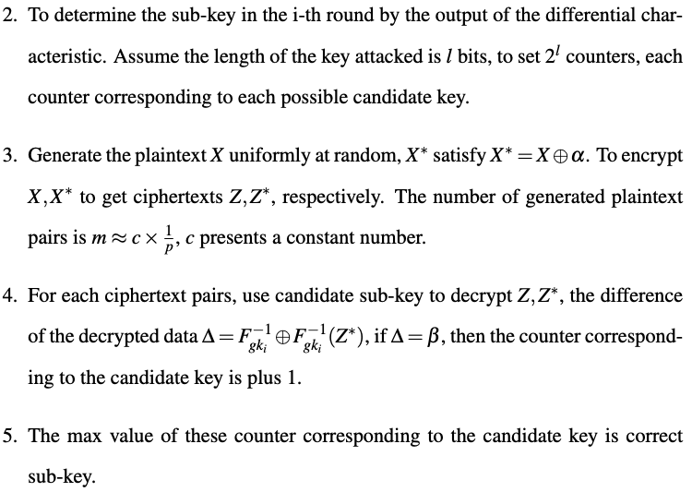
Background-Differential Attacks
The element of DDT satisfy:
Put research pictures here
Table 2. DDT for present cipher
Notes:
I think you can skip this slide.

Slide 11
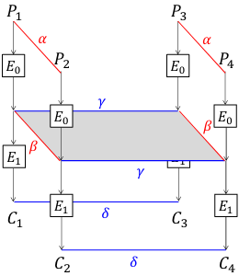
Background-Boomerang Attacks
The boomerang attack is based on differential cryptanalysis.
It is a chosen plaintext attack and is used to analyse symmetric cryptography, compare to differential cryptanalysis, which provides a more efficient method to analyse more complex ciphers.
The boomerang attack attempts to generate a quartet structure at an intermediate value halfway through the cipher and it split an entire differential trails into two sub-trails.
Fig 2. Boomerang Attack
Notes:
Boomerang is not the most powerful method. I modified the sentence accordingly.

Slide 12
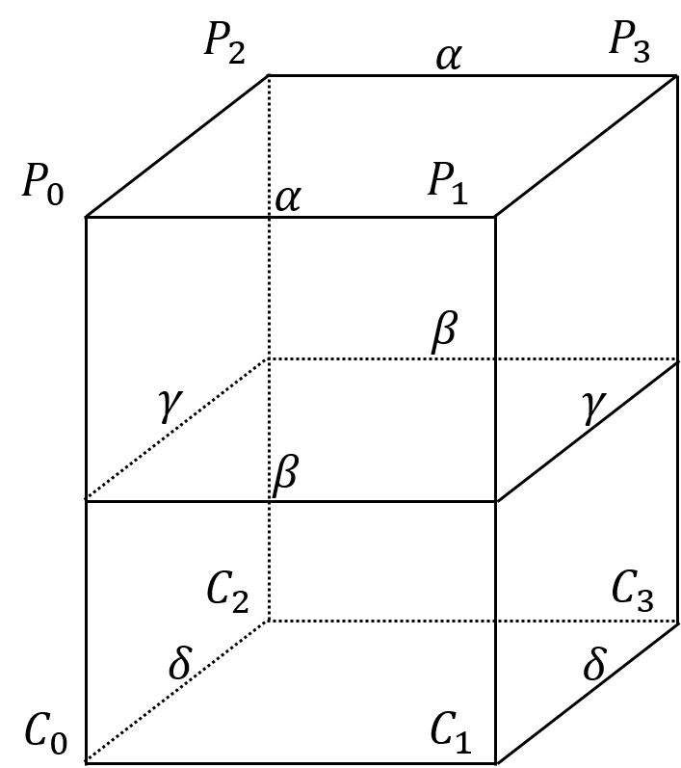
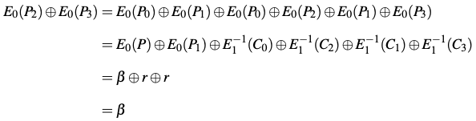

Background-Boomerang Attacks
Four plaintexts P1, P2, P3,P4 and with their respective ciphertexts C0, C1, C2, C3.
The E(·) present the encryption operation and decompose the cipher into E = E1 ◦ E0 where E0 represent the first half of the cipher and E1 presents last half.
There are four differential trails, α → β for $E_{0}$;r → δ for $E_{1}$ ; δ → r for $E_{1}^{−1}$ and β → α for $E_{0}^{−1}$
Fig 2. Boomerang Attack

Slide 13
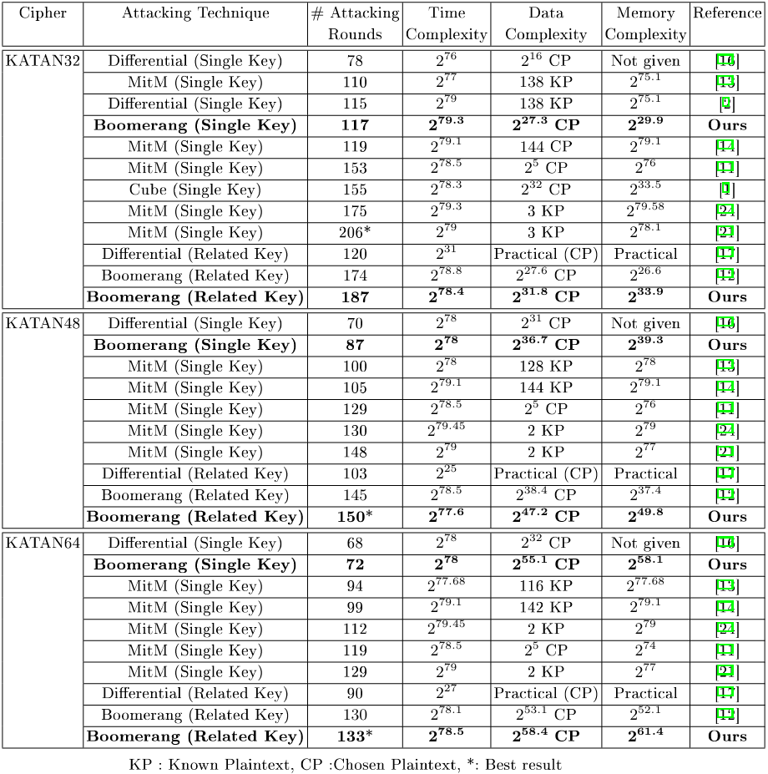
LITERATURE REVIEW
The best differential attack on KATAN used an extended boomerang attack in related-key setting was proposed by Chen et al.
However, a recent study reported that the result of boomerang attacks(including the amplified boomerang attack, and the rectangle attack) may not be valid by Murphy (2011).
Figure 3. Comparison of attacks against KATAN family.
Notes:
Add the citations based on your list of references behind.

Slide 14
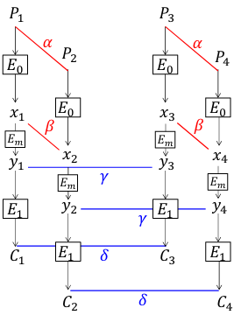
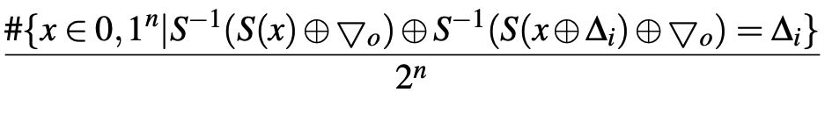
LITERATURE REVIEW
Murphy (2011) published results of several experiments, to demonstrate the boomerang analysis can commonly give highly inaccurate probability values and he shows the boomerang attack is used to analyse DES and AES on some parameters, then the boomerang never comes back.
For the problem, Cid et al. (2018) gives a solution. It proposed new tools to improve the reliability of the sandwich attack, called Boomerang Connectivity Table (BCT).
The sandwich attack is a boomerang-style attack depicted in Fig 4, it defines E = E1 · Em · E0 where Em is a relatively short operation satisfying some differential propagation among four texts with probability r, then the entire probability is p2q2r.
The BCT can evaluate r in efficacy and easy-to-understand way when Em is composed of a single S-BOX layer. In this situation, for a given pair of (∆i,▽o), the probability that a right quartet is generated in each S-BOX in the middle S-BOX layer is given by:
Fig 4. Sandwich Attack
Notes:
Boomerang Connectivity Table is BCT not BTC. Please fix the error so you will remember.

Slide 15
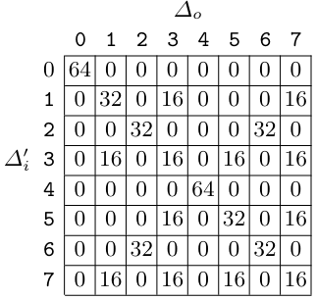
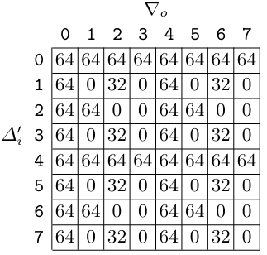
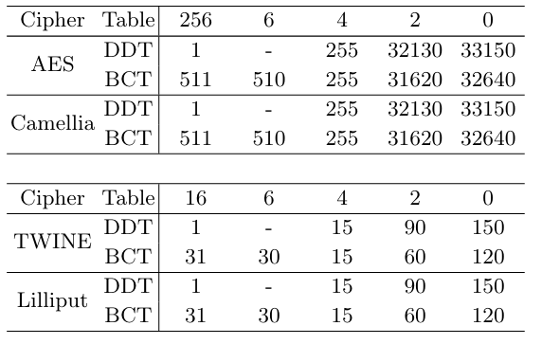
LITERATURE REVIEW
The left table shows the advantage of BCT, the BCT can find differentials with higher probability for ciphers based on S-BOX.
The right tables only shows the advantage of BCT for ciphers based on Modular Addition, but the paper does not give practical examples.
<No work has been done for AND operation>
Tab 5. DDT of 3-bit modular addition with ∆i = 0
Tab 6. BCT of 3-bit modular addition with ∆i = 0
Tab 4. Number of entries for each value for the DDT and BCT for the S-boxes in AES,Camellia, TWINE and Lilliput
Notes:
Again you have BTC here. Be careful. Highlight that no work was done for ciphers based on the AND operation (such as KATAN).

Slide 16
Project Purpose
The research questions of the study include:
How can BCT be adapted to non-S-box ciphers?
Are the boomerang attacks on KATAN valid?
Can the boomerang attacks on KATAN be improved?
The specific goals of the study include:
To propose BCT for the AND operation.
To investigate the validity of past boomerang attacks on KATAN
To propose improved boomerang attacks on KATAN
Notes:
I suggest to remove the box above (unless you need it to help with presentation).

Slide 17
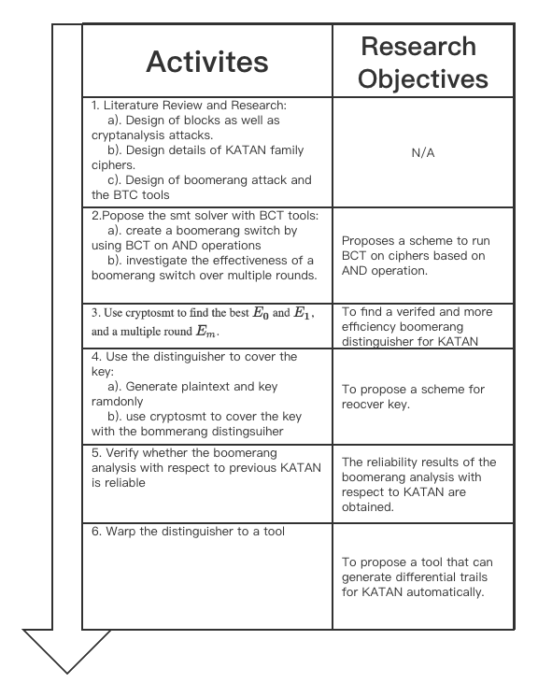
Methodology
The nonlinear part of KATAN is AND operation
BCT has not been implemented on ARX ciphers.
Report: This research Current stage is Active 2, to find a scheme make BCT can be used on cipher based on AND operation.
Figure 4. Research Methodology
Notes:
Again, there is a “BTC” error.
For the table on the left, “Research Objectives” column wrong. It should have the same content as the 3 research objectives highlighted in the previous slide. Check each of the steps and try to map them to one of the following. This is important.
To propose BCT for the AND operation.
To investigate the validity of past boomerang attacks on KATAN
To propose improved boomerang attacks on KATAN
After this slide, add a conclusion section to highlight what is the next step in the research.

Slide 18
Reference
Biham, E., Dunkelman, O., & Keller, N. (2001). The rectangle attack—rectangling the serpent. In International conference on the theory and applications of crypto- graphic techniques (pp. 340–357).
Biham, E., Dunkelman, O., & Keller, N. (2005). A related-key rectangle attack on the full kasumi. In International conference on the theory and application of cryptol- ogy and information security (pp. 443–461).
Biham, E., & Shamir, A. (1991). Differential cryptanalysis of des-like cryptosystems. Journal of CRYPTOLOGY, 4(1), 3–72.
Biryukov, A., De Cannière, C., & Dellkrantz, G. (2003). Cryptanalysis of safer++. In D. Boneh (Ed.), Advances in cryptology - crypto 2003 (pp. 195–211). Berlin, Heidelberg: Springer Berlin Heidelberg.
Biryukov, A., & Khovratovich, D. (2009). Related-key cryptanalysis of the full aes- 192 and aes-256. In International conference on the theory and application of cryptology and information security (pp. 1–18).
Chen, J., Teh, J. S., Su, C., Samsudin, A., & Fang, J. (2016, 07). Improved (related- key) attacks on round-reduced katan-32/48/64 based on the extended boomerang framework. In (Vol. 9723, p. 333-346). doi: 10.1007/978-3-319-40367-0_21
Cid, C., Huang, T., Peyrin, T., Sasaki, Y., & Song, L. (2018). Boomerang connectivity table: A new cryptanalysis tool. In J. B. Nielsen & V. Rijmen (Eds.), Advances in cryptology – eurocrypt 2018 (pp. 683–714). Cham: Springer International Pub- lishing.
De Cannière, C., Dunkelman, O., & Kneževic ́, M. (2009). Katan and ktantan — a family of small and efficient hardware-oriented block ciphers. In C. Clavier & K. Gaj (Eds.), Cryptographic hardware and embedded systems - ches 2009 (pp. 272–288). Berlin, Heidelberg: Springer Berlin Heidelberg.
Dunkelman, O., Keller, N., Ronen, E., & Shamir, A. (2020). The retracing boomerang attack. In Annual international conference on the theory and applications of cryp- tographic techniques (pp. 280–309).
Dunkelman, O., Keller, N., & Shamir, A. (2010). A practical-time related-key attack on the kasumi cryptosystem used in gsm and 3g telephony. In Annual cryptology conference (pp. 393–410).
Dworkin, M. J., Barker, E. B., Nechvatal, J. R., Foti, J., Bassham, L. E., Roback, E., . . . others (2001). Advanced encryption standard (aes).
Dworkin, M. J., et al. (2015). Sha-3 standard: Permutation-based hash and extendable- output functions.
Kelsey, J., Kohno, T., & Schneier, B. (2000). Amplified boomerang attacks against reduced-round mars and serpent. In International workshop on fast software en- cryption (pp. 75–93).
Matsui, M. (1993). Linear cryptanalysis method for des cipher. In Workshop on the theory and application of of cryptographic techniques (pp. 386–397).
Murphy, S. (2011). The return of the cryptographic boomerang. IEEE Transactions on Information Theory, 57(4), 2517-2521. doi: 10.1109/TIT.2011.2111091
Pub, F. (1999). Data encryption standard (des). FIPS PUB, 46–3. Shannon, C. E. (1949). Communication theory of secrecy systems. The Bell System
Technical Journal, 28(4), 656-715. doi: 10.1002/j.1538-7305.1949.tb00928.x Wagner, D. (1999). The boomerang attack. In L. Knudsen (Ed.), Fast software en-
cryption (pp. 156–170). Berlin, Heidelberg: Springer Berlin Heidelberg.

Slide 19

Thanks for your attention
Notes:
Change the UniMelb logo here.

Slide 20
THE END

